Slide 1



Introduction to Git
In the next few slides you will learn more about git, git workflow, VCS, GitHub and its basics.

Slide 2
Things to keep in mind
Before we start, check this out :-
“There is always a person in a room who knows more than you. I rather be that guy” - Person
We will make a new friend, it is called Google.
Don’t rush, take it slow. Understand each step. CRYSTAL.
Ask silly questions. People who ask questions. Self understanding is important.
If I am going fast, Be responsible and tell me yourself. Don’t wait for others.
Notes:
I don’t consider myself to be the expert.

Slide 3
VCS (Version Control System)

Slide 4
What does VCS do for you ?
Keeps track of your work and output of your work that is your code.
Keeps tracks of exactly what is changed.
Keeps tracks of who makes those changes.
Keeps tracks of why the changes were made.
Every real project you will ever make will be build using these platforms only.

Slide 5
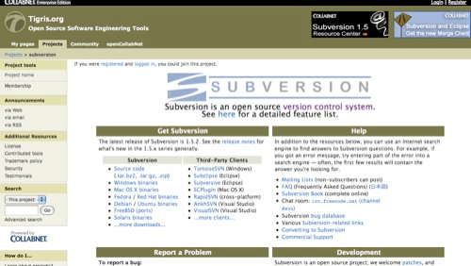
Examples of VCS
SVN - Subversion

Slide 6
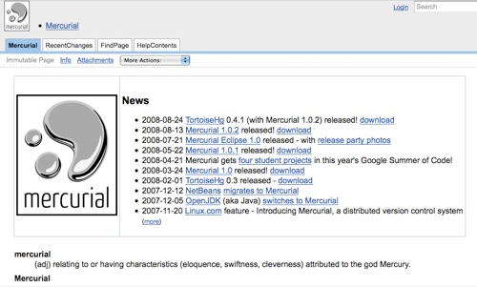
Examples of VCS
Mercurial - tuned for performance

Slide 7
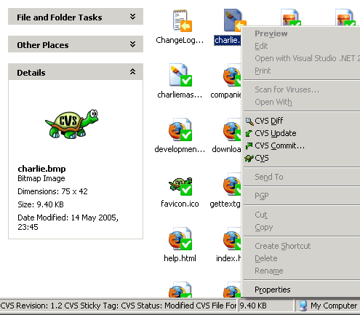
Examples of VCS
CVN - Grandfather of all

Slide 8
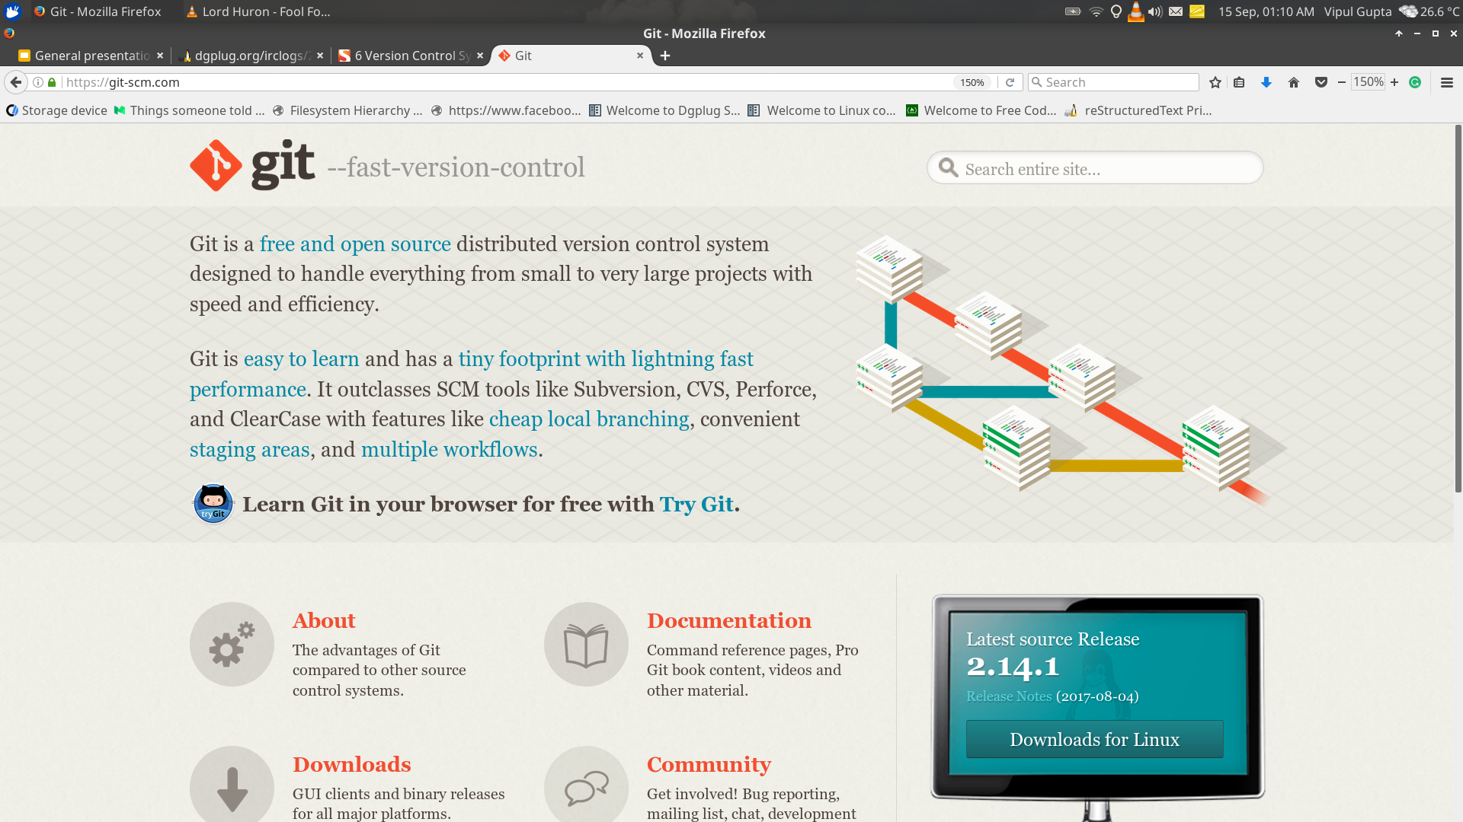
Examples of VCS
git - Modern, popular and the one you are going to learn

Slide 9

git --distributed-even-if-your-workflow-isnt It is a type of VCS where you can modify code without actually overwriting anything, collaborate and work easily. With seperate workflows using branches.
GitHub
It is code hosting platform for version control and collaboration. It lets you and others work together on projects from anywhere and harness the true power of git.

Slide 10
You sold. Anyone wants to leave. Now is the time.
Notes:
*- *Chapter 1: Understanding VCS: Commits* [13:45] <sayan> *- Next day morning you start reading VCS, scratching your head to get around with all the terms
[13:46] <sayan> *- The first one that you hit is commits, so what is commit (or snapshot?) [13:47] <sayan> *- So you thought of writing a series analogy stories to learn the concepts better :) [13:47] <sayan> *- You create a new character, Tux [13:47] <sayan> *- Tux wants to be photographer, who has just bought a new DSLR. [13:48] <sayan> *- Tux plan to be the next travel photographer, who would take the best picture from the top of Mt. Everest [13:49] <sayan> *- But Tux is a newbie, so Tux starts watching for YouTube tutorials for learning to post process the images. [13:49] <sayan> *- Tux creates a directory named *working* to put all un-processed images. <<-- mind *working* is to be focused here [13:50] <sayan> *- Then, fires up DarkTable to process the images. [13:50] <sayan> *- Every time after a set of similar operations (like crop & rotate, shadows & highlights, etc), Tux creates a copy of the *working* directory and names it `snapshot-{n}` [13:51] <sayan> *- After a couple of operations, Tux stands having "snapshot-1", "snapshot-2", "snapshot-3", .... , "snapshot-100" directories. [13:52] <sayan> *- This directories is history of how Tux developed the image over time. At any point, Tux can go back to a given snapshot and build again on top of it.
Git is version control software, which means it manages changes to a project without overwriting any part of that project. And it’s not going away anytime soon, particularly since Torvalds and his fellow kernel developers employ Git to help develop the core kernel for Linux.
Why use something like Git? Say you and a coworker are both updating pages on the same website. You make your changes, save them, and upload them back to the website. So far, so good. The problem comes when your coworker is working on the same page as you at the same time. One of you is about to have your work overwritten and erased.
A version control application like Git keeps that from happening. You and your coworker can each upload your revisions to the same page, and Git will save two copies. Later, you can merge your changes together without losing any work along the way. You can even revert to an earlier version at any time, because Git keeps a “snapshot” of every change ever made.
The problem with Git is that it’s so ancient that we have to use the command line—or Terminal if you’re a Mac user—in order to access it, typing in snippets of code like ‘90s hackers. This can be a difficult proposition for modern computer users. That’s where GitHub comes in.

Slide 11
Start GitHub tutorial
Login to your GitHub account
FORK this repo http://tiny.cc/vanilla
git clone <upstreamRepoURL> vanilla
End Github Tutorial
http://tiny.cc/noshit
http://tiny.cc/jainpost
http://tiny.cc/gotvideo
Notes:
*- *Chapter 2: Understanding VCS: Staging Area* [13:55] <sayan> *- It's been a month now, Tux have learned a lot on post-processing images. [13:55] <sayan> *- Tux now mixes and matches multiple images file to create a snapshot directory. [13:56] <sayan> *- One day, Tux while processing the images, goes into experimental mode. [13:56] <sayan> *- and only after a while realized that the changes should be going into two [13:57] <sayan> *- different snapshot directories (`snapshot-139` & `snapshot-140`). [13:57] <sayan> *- Smart Tux quickly thought of an idea, creates a new staging directory. [13:58] <sayan> *- A staging directory works as an intermediate between the working directory [13:58] <sayan> *- and the snapshot directory. [13:58] <sayan> *- So, Tux now works on working directory, and one Tux is happy with the changes [13:59] <sayan> *- Tux moves all changed files into staging directory, and then creates a copy of the staging directory as new snapshot directory

Slide 12
Start Git Tutorial
$ git config --global user.name "John Doe"
$ git config --global user.email johndoe@example.com
git init - Initialize a directory for git - Try in your cloned directory
git add - Snapshot 1.txt >> Snapshot 2.txt
git status - After Snapshot 2.txt is saved
git commit - Commit Snapshot 2.txt
git status - again
git log - check your log
Change something in Snapshot 2.txt
git diff
Repeat the same from step 5
3 times
git remote -v
git add remote upstream www.github.com/vipulgupta2048/vanilla
Git push origin master

Slide 13
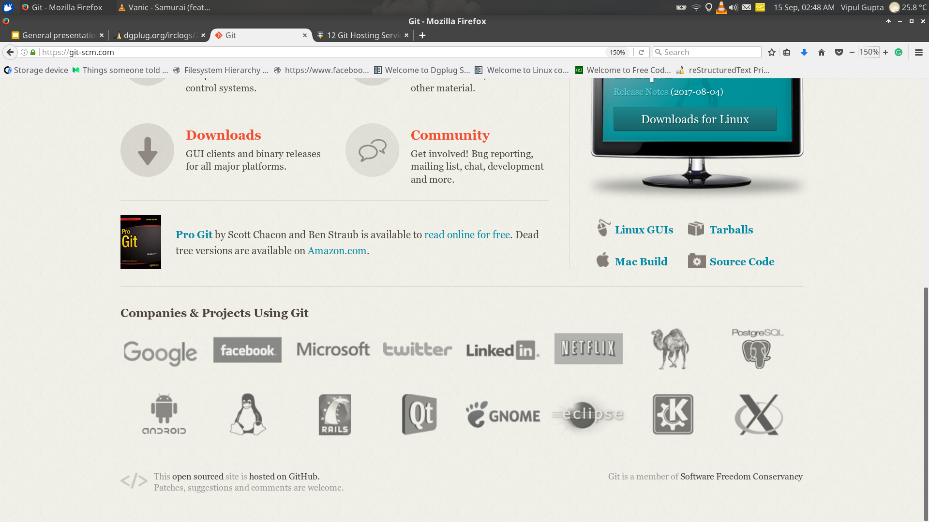
Companies that use git.

Slide 14
Links for more information.
How to progress.
How to find new projects.
How to do new things.
How github is used by teams and meetup groups to collaborate and work together.

Slide 15
https://git-scm.com/book/en/v1/Getting-Started-About-Version-Control
https://www.joshmatthews.net/bugsahoy/ https://github.com/coding-blocks https://github.com/ILUGD/ https://github.com/asetalias/ http://lym.readthedocs.io/en/latest/ http://sethrobertson.github.io/GitFixUm/fixup.html Stack Overflow Documentation - Read.the.docs. _RTFD_ https://try.github.io https://www.atlassian.com/git/tutorials/using-branches https://github.com/Roshanjossey/first-contributions http://ohshitgit.com/ https://github.com/Roshanjossey/first-contributions/blob/master/additional-material/Useful-links-for-further-learning.md

Slide 16
Alternatives to GitHub if you are crazy enough to try
Gitlab(in some ways better than even GitHub)
Bitbucket
Microsoft Visual Studio Team Services
CloudForge
Openforge - Indian

Slide 17
“Learn 3 things in life. Git, a programming language and how to speak in public.”
- Anuvrat Parashar

Slide 18
Any questions??
Return 0;
Feedback

Slide 19

Thanks !!
Vipul Gupta
B.Tech, 2nd year,
Amity University
Core ALiAS member, blogger, Linux enthusiast and sometimes sarcastic.
www.mixstersite.wordpress.com
@vipulgupta2048 [GitHub, Facebook, LinkedIn, Gmail]

